Slide 1


Assessing the Sensorimotor Aspects of Voice Work
Sheila M. Frick, MS, OTR/L

Slide 2
Framework Background

Slide 3
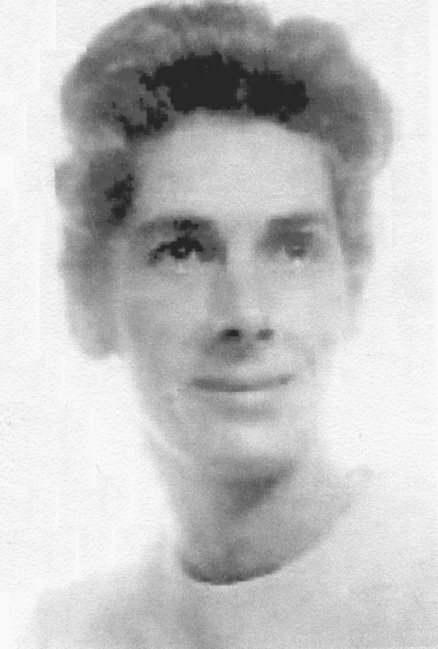
Sensory Integration
“Sensory Integration is the neurological process that organizes sensation from one’s own body and from the environment and makes it possible to use the body effectively within the environment......
Ayres, 1972 (p. 11)

Slide 4
Sensory Integration
Understanding how a child is processing information about his/her world provides important insight into the child’s learning
Internal information comes from the bodily processes and sensations; and external information includes all the sights, sounds and experiences that happen in environment

Slide 5
Key Components of Change
Sensory integration is necessary for development, flexibility, and participation
Experience changes the structure, function and organization of the brain
Active engagement in sensory experience produces an adaptive response
  Adaptive response: higher level skill/response than previously demonstrated
Adaptive responses to sensation optimize overall performance and development
Notes:
Maybe just notes for previous slide???

Slide 6
Assessing Contributing Factors
Gain insight into how individual is processing and responding to sensation from self and environment
Examine developmental sequence
  Primary movement patterns
Assess resulting impact on functional participation limitations
  Used to set client specific goals

Slide 7
Sensory Motor History
Looks at how one responds to sensation across all senses the impact on daily life
    Tactile
    Vestibular
    Auditory
    Olfactory
    Proprioceptive
    Visual
Response
    Over, under, and unusal responses
    Impact on arousal and emotions
    recovery
Notes:
Can train motor coordination and skill, but need the foundation of resiliency and orientation to develop higher level skills
Bias towards defense and resiliency/ability to recover
Ability to Orient to Environment and Others
Motor Coordination and Skill Development

Slide 8
Active Voice Work
From a sensory integrative and developmental framework, active voice work requires:
  Posture and breath are the key
    Integration of primary movement patterns form the basis for posture
    Alignment around the central vertical axis
    Animated by breath
    Quality of integration predicts alignment and breath
Notes:
Primary movement patterns and an individual’s response to sensation and movement impact’s their overall ability to engage in active voice work

Slide 9
Active Voice Work
From Dr. Alfred Tomatis’ perspective:
  “The act of vocalizing, of speaking as well as singing, remains one of the highest and most intricate motor activities of the human being. It involves the whole body” – citation

Slide 10
Jack Sensory Motor History

Slide 11
Primary Movement Patterns

Slide 12
Sensorimotor Patterns of Survival and Engagement
High Route
Fear Paralysis
Moro
Orienting
Low Route
Notes:
What wires together fires together- create new pathways
When we have poor sensory processing it sets the individual up to be tripped by the low route of processing. What fires together wires together so if you keep tripping the pathways of the low route with your sensory system you are more apt to stay stuck in this pathway
However, you need to try to set-up triggering the high route the more efficiently you can process sensation you can tap into higher level processing

Slide 13
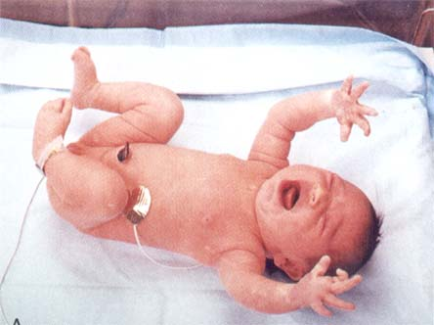
The Moro Response
The first breath
Early postural foundations
Connections to fright, flight, freeze

Slide 14
Moro Response
Elicited at birth with sudden noise or sudden change in the support surface
Initial phase UE and LE extension, hands open fingers extend and abduct, sharp inhale, finger extension is the first to develop
Second phase gradual return to arms across the body, hands clasped, exhale
Allows for the first extension and inhalation after months of flexion

Slide 15
Moro Response
First Phase:
Associated with sympathetic nervous system activation
Release of adrenaline
Increase in breath and heart rate
Rise in blood pressure
Second Phase:
Exhale- parasympathetic nervous system activation
Return to midline

Slide 16
Moro Response
Developmental date (foreground) between 2-3 months then becomes progressively weaker by 6 months into a more mature startle response (background) when more mature anti-gravity devlopment

Slide 17
Moro Response
Lack of integration associated with defensive responses to non noxious sensation( especially sound and movement)
Possible photosensitivity due to pupillary dilation

Slide 18
Moro Expression Dependent on Development
Full expression is dependent on adequate sensory processing especially auditory, vestibular and proprioceptive
Developmental considerations
  Fetal curl, seen later as breath holding tension in core
  Tension in extremities (extension and abduction), sharp inhalation
  Release with exhale and return to midline
  Mature startle, orienting response
Notes:
Changed Title from: “Moro Development in Relationship to Core” – did not seem to fit for this presentation

Slide 19
Moro Development in Relationship to State Regulation
The breath in relationship to sudden change in the environment (movement, sound, peripheral field activation)
Sensory processing challenges
  Lack of response- breath due to holding and tension in the belly: breath not activated to regulate response to the environment
  First phase- sharp inhale without return to center and exhale- fight flight
  Freeze
Notes:
Videos jack, Australia, lab with matt fall (Changed Title from: “Moro Development in Relationship to Core” – did not seem to fit for this presentation)

Slide 20
Evaluation and Facilitation:
Broadening One’s Range of Response & Recovery
Evaluate the expression of the pattern
Things to assess:
  Breath
  Tonal and postural response to sudden change
  Tonal response throughout the core and extremities
  Facial expression
Consider the sensory input necessary to trigger and the intensity of input

Slide 21
Identification of State
Body movements
Eyes
Facial expression
Skin tone
Breath patterns
Level of responsiveness

Slide 22
Moro Assessment
Client lying supine on the floor with arms relaxed resting on the floor
Instruct client that examiner will be making a loud sound by their head
Wait several seconds and observe starting respiration and breath
Using palms of hands, examiner makes a loud sound by slapping both hands on the ground several inches from client’s ears
Client lying supine knees bent feet on the floor swiftly sweep client’s feet out from under them

Slide 23
Moro Assessment
Clinical observations
  Breath in response to sudden change (sound, movement, …)
  Extremity tone in response to movement
Facilitation
Integration
  Modulate sensation so that you can regulate respiration and extremity tone for postural responses
  Secure anti-gravity development

Slide 24
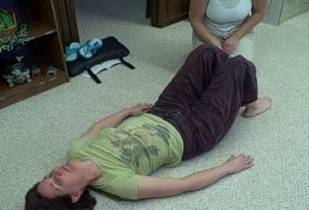
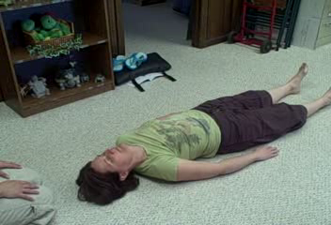
Moro Response
Moro
Leg Sweep

Slide 25
Tonic Labyrinthine
Emerges at birth
Backward movement of head increases extensor tone
Forward movement of head causes increase in flexor tone
Forward integrated by 4 months of age
Backward integrated by 3 years
Notes:
25
Movement of head off of central axis

Slide 26
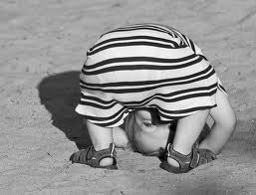
Tonic Labyrinthine Reflex
Change in muscle tone relative to change in head position to support mastering gravity and gain head and neck control after birth
Aides in the development of muscle tone and the proprioceptive and vestibular senses
  Correct alignment of head with body
  Central spatial reference point for integration
www.breathingtimeyoga.com
Notes:
26

Slide 27
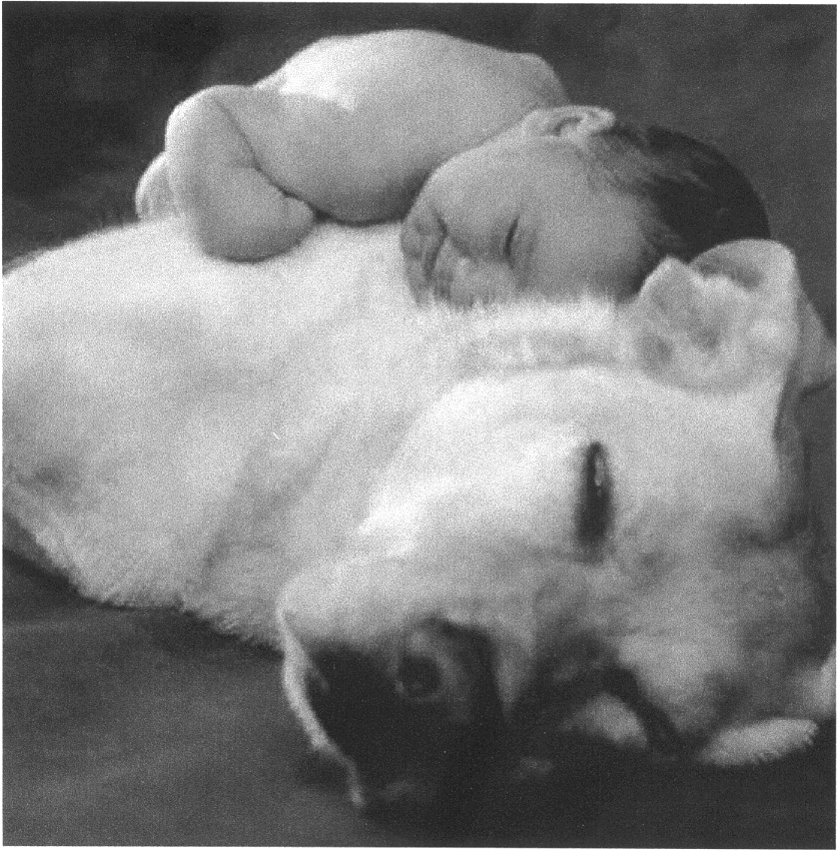
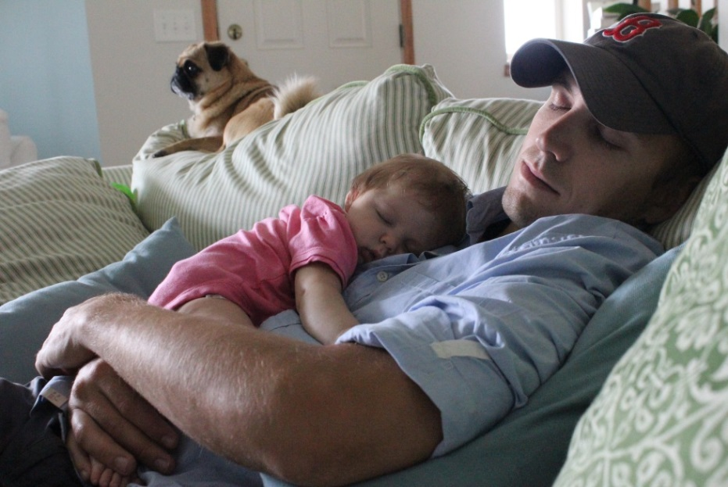
Tonic Labyrinthine
Front - Back
Basis for grounding

Slide 28
Tonic Labyrinthine
Emerges at birth (foreground), extension of the head below the level of the spine causes immediate extension of the arms and legs
Backward movement of head increases extensor tone
Forward movement of head causes increase in flexor tone
Developmental Dates (recede to background):
  Forward integrated by 4 months of age
  Backward integrated by 3 yrs

Slide 29
Tonic Labyrinthine
Integrates with vestibular postural responses as you gain control of body in antigravity postures:
  Prone extension
  Supine flexion
As righting (labyrinthine, visual, auditory) emerges and assists in lifting head

Slide 30
Tonic Labyrinthine
Lack of integration seen in gravitational insecurity, hyper-sensitivity to vestibular input
Postural ocular disorder
Balance and audition

Slide 31
Tonic Labyrinthine
Assessment
  Client standing with both feet together
  Make sure clients knees are not locked
  Tilt clients head backwards (up towards ceiling) and have client close eyes
  Maintain position for 10 seconds
  Tilt clients head forward (looking towards toes) and have client close eyes
  Maintain position for 10 seconds

Slide 32
Tonic Labyrinthine
Clinical observations
  Maintain static balance with changes in head position (both forward and backwards)
  Note any changes in muscle tone
  Note gripping support surface with toes
  Note reports of dizziness or nausea
  Able to maintain vision occluded
  Observe overall tone with change in head position

Slide 33
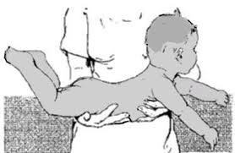

Landau
Full body extension that counterbalances newborn’s total body flexion (phasic)
Fully developed by 6 months (foreground), airplane position, at the time that infant starts to rotate on belly in full extension in circle
Integrated in the third year of life once a secure and mobile walker (background)
Notes:
aThe Landau reaction is elicited by supporting the infant horizontally in the air in the prone position. The reaction is present if the infant raises his head and arches his back with the concavity upwards. A subsidiary part of the response is partial extension of the lower limbs at the hip-joints.
The reaction may be elicited in normal infants from the age of about 3 months onwards, is present in most infants in the second six months of life, and becomes increasingly difficult to evoke after the age of one year.
Absence of the response in infants over the age of 3 months is seen in association with motor weakness, as in cerebral palsy, motor neurone disease and mental retardation.
The Landau reaction represents the combined effects of labyrinthine, neck and visual reactions.
About the balance in the patterns, see athletes who are very stiff and present with difficulty breathing with a bias towards extension

Slide 34
Landau
Assessment, after age three, should be able to lift head and chest in prone without a significant influence of extensor tone throughout the trunk
Proprioceptive neuromuscular facilitation
  Able to assume pivot prone position and hold 20 seconds
  Able to lift head, chest, and upper extremities without significant influence of extensor tone
Key hallmark for vertical alignment in standing

Slide 35
Landau
Assessment:
  Prone on ball, lift full body and balance
  Prone on ball, lift only head, chest, and extremities
  Examine qualities of extensor tone in both positions

Slide 36
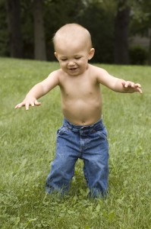
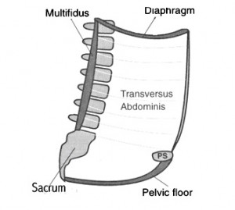
Assessment of Core Activation
What is the core?
  Deep postural muscles necessary for anti-gravity postural control
  Activation of the inner core (anchors all other postural muscles):
    Respiratory Diaphragm
    Transverse Abdominus
    Pelvic Floor
    Multifidus
enabledkids.ca
bretcontreras.com
Notes:
Shelly Mannell and Julie Wiebee references for the inner core—articles from the adult PT literature (NDT framework). We have translated their work into SI treatment. The Hodges respiratory diaphragm.
In a number of studies, these muscles have been shown to activate prior to movement, providing an anchor for outer core muscles
Science, inner, outer core and posture
What we know from physical sciences- Hodges

Slide 37
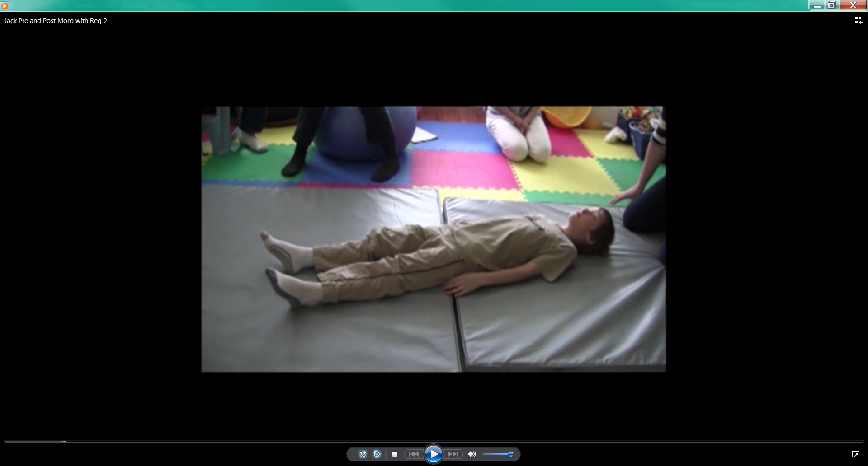
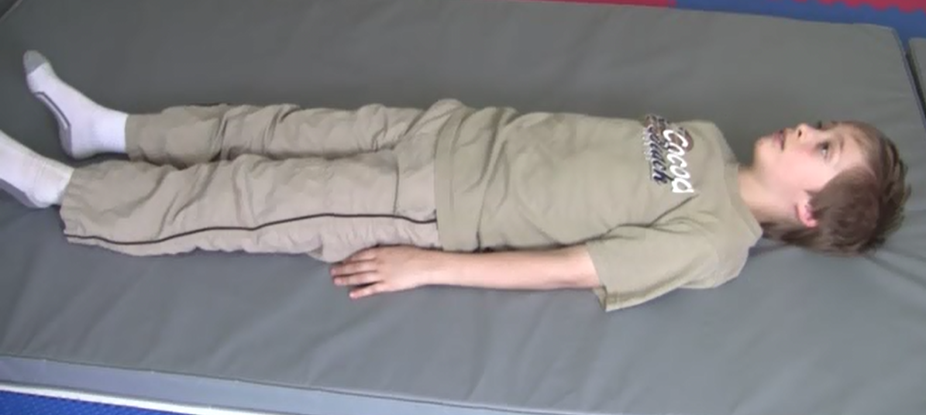
Assessment of Core Activation
Pre Moro Assessment
Post Moro Assessment

Slide 38
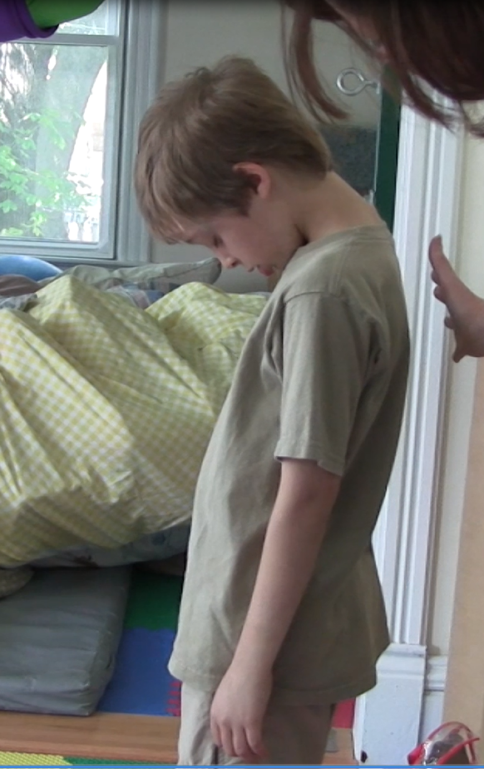
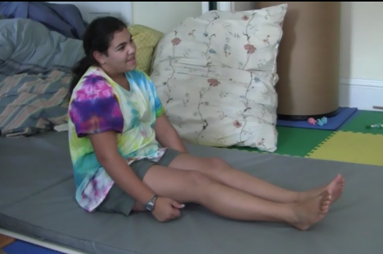
Assessment of Core Activation

Slide 39
Thank you!
Next lecture moving from assessment to treatment principles

