Slide 1


Sensorimotor Development of Active Listening
Sheila M. Frick, MS, OTR/L

Slide 2
Background for Active Listening
A Historical Perspective

Slide 3


Listening and Sensory Integration
Dr. Alfred Tomatis
Dr. A. Jean Ayres
http://www.tomatis.com/en/the-group/history-and-development.html
Notes:
Dr . Tomatis the era as an integrator of sensory information, the links between posture and voice and the necessity of an active listening posture
Vestibular system master intgrator linkss between postural development and visual percepltion and learning, talked about the early sensorimotor atterns tha were necessary for antigraivity control and one ablity to orient and engage how early sensorimotor patterns influece higher level development
Both recognised the ear sensation from the environment and body, the need for controled sensory niput and the need to act on or adapt to that input
To form new perceptions
Ayres: recognized the importance of vestibular input and primary movement patterns/primitive for development/postural alignment to engage and participate in the world

Slide 4
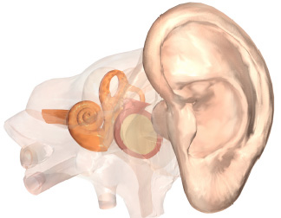
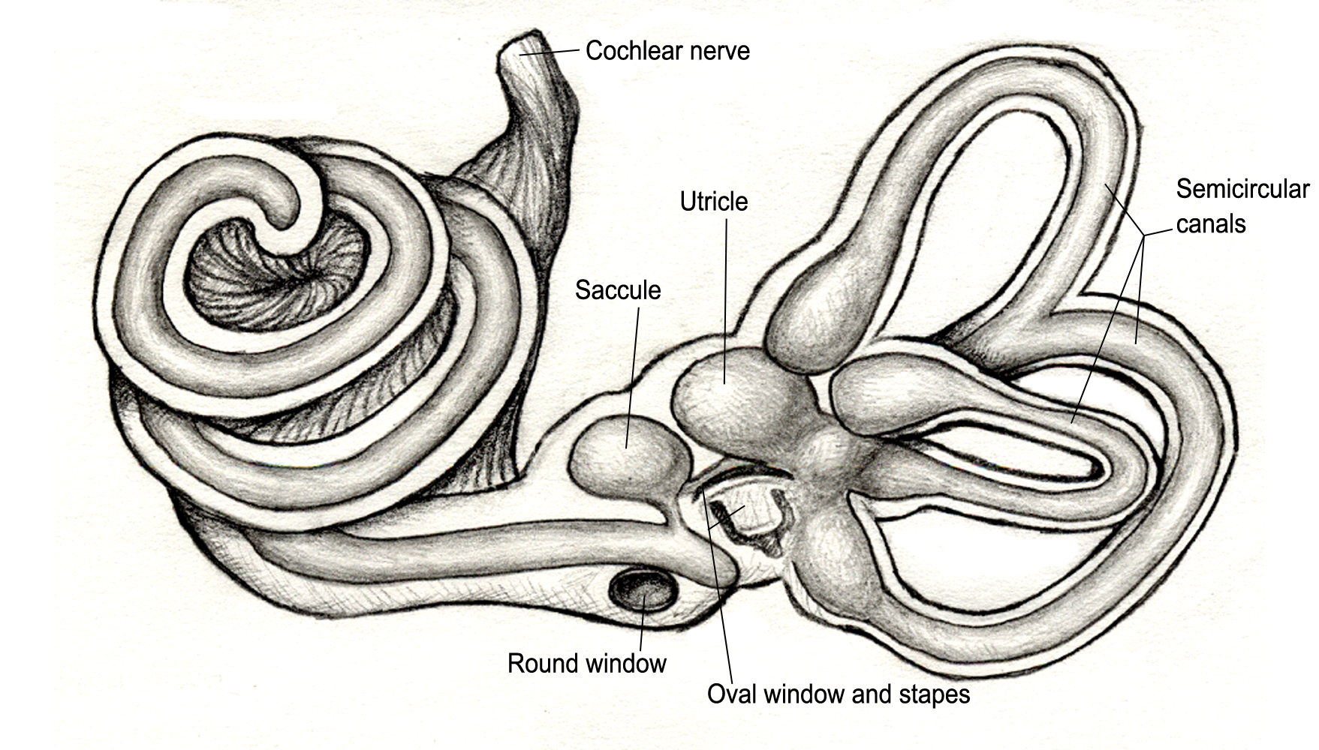
Inner Ear as a Sensory Processor
©Vital Links 2007

Slide 5
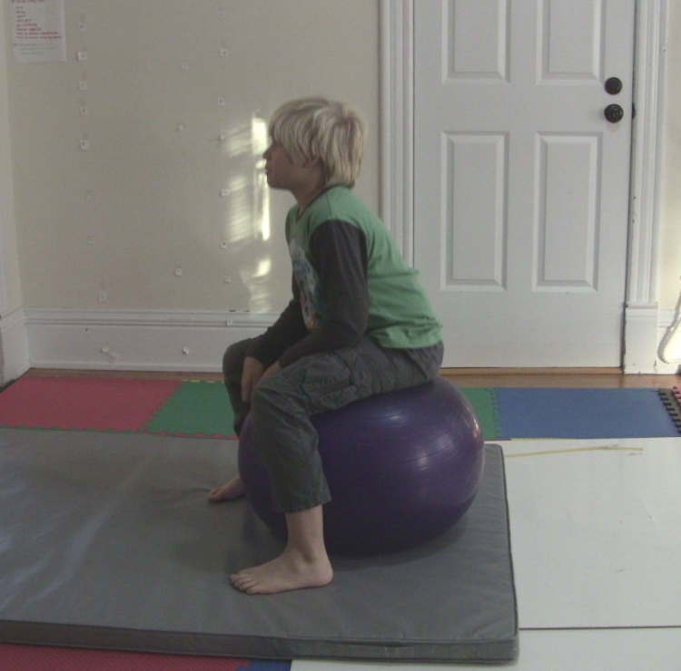
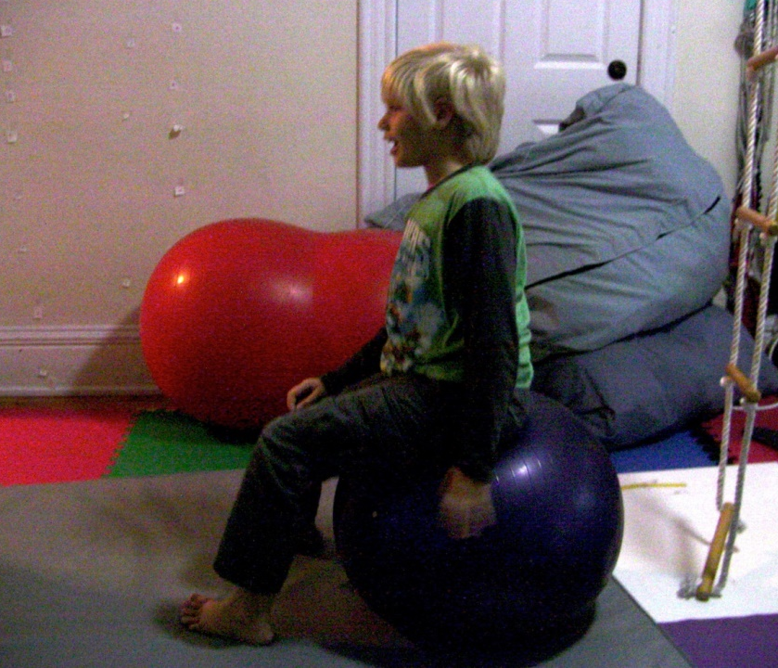
Dynamic Posture
Mastery of gravity is critical for ones ability to achieve and maintain an “active listening posture”
Notes:
Posture and movement: how one responds to gravity and sudden changes within the environment predict how well you are able to activate posture and breath
Early patterns are the scaffolding/support for posture and movement
Early movement patterns plus sensory input (change)/adapt comes back to sensory input; how patterns are used and adapted become the first thing you use to respond to the environment as you respond thes patterns change; triggered by sensation and poor sensory motor processing can lead to incomplete or inefficieint sensory motor expression
Typical part of development, can influence emotional state and postural development as well as the use of the visual and auditory attention if they are present beyond their developmental dates they will disrupt development of posture, balance, and regulation of affect (always present in the wiring of the brain, but only expressed beyond an age if there is damage to the brain or stress in the system or asked to accomplish a task beyond your skill level at that moment)
Sensory input is processed through multiple sensory motor networks throughout the brain
Without them undeveloped and inefficient- challenges with interaction, engagement, and higher level participation (fullest level of expression of ourselves)

Slide 6
Understanding Sensory Motor Aspects of Voice

Slide 7
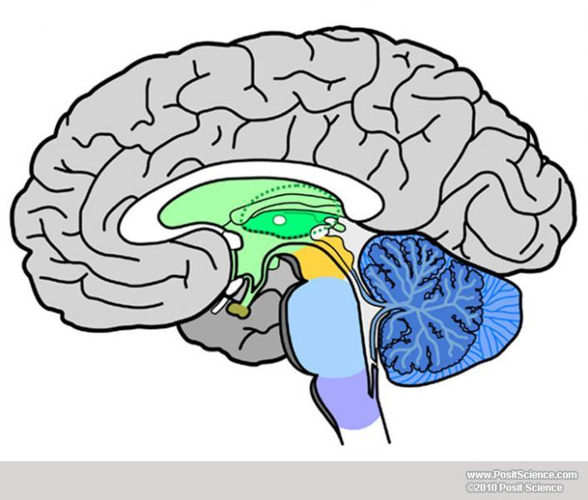
Sensorimotor Affective Processing
Frontal Lobe
Judgment
Mood
Attention
Motivation
Limbic System
Evaluative System (evaluates based upon survival)
Emotion
Behavior
Motivation
Long-Term Memory
Brainstem
Survival Functions: heart rate, breathing, sleeping, eating
Primary Movement Patterns
Protective Patterns of Fight/Flight/Freeze
Arousal/ Sleep/Wake
Work together to process affective/emotional qualities of sensation
Notes:
Pictorial of how sensation and arousal
Flip your lid- how you process sensation impacts your ability to access your frontal lobe

Slide 8
Postural Development/Sensory Integration
To be able to move automatically, fluidly, and adaptably, one needs to:
  Ability to position self in space
  Receive consistent information from your body and its relationship to the environment (space, place, and time)
  Orient, attend and learn information in an organized manner
  Spatial Organization - Bilaterality - Laterality - Praxis

Slide 9
Primary Movement Patterns
“Kinetic modules available for motor programming”
Available throughout lifespan to support development and function
Provide ongoing interpretation of the developmental process through examining the PMP
Adapted from Adriano Milani Comparetti, M.D.

Slide 10
Primary Movement Patterns
Emerge during “developmental dates”
  Correspond to limited window when one PMP is prominently in the foreground
“Foreground”
  Serves a developmental purpose
  Supports a new skill, function or tonal contribution
“Background”
  Combines with other patterns to support new functions
Adapted from Adriano Milani Comparetti, M.D.

Slide 11
Primary Movement Patterns
If the PMP do not fully develop, those patterns will not be part of one’s movement repertoire
Underlies the development of more mature postural and movement patterns
Reflection of the sensorimotor integration, CNS organization

Slide 12
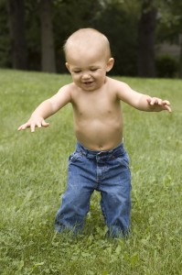
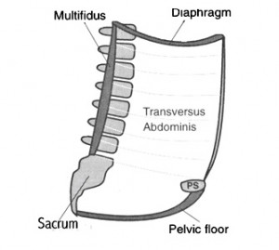
Supporting Gains with Core
What is the core?
  Deep postural muscles necessary for anti-gravity postural control
  Activation of the inner core (anchors all other postural muscles):
    Respiratory Diaphragm
    Transverse Abdominus
    Pelvic Floor
    Multifidus
enabledkids.ca
bretcontreras.com
Notes:
Shelly Mannell and Julie Wiebee references for the inner core—articles from the adult PT literature (NDT framework). We have translated their work into SI treatment. The Hodges respiratory diaphragm.
In a number of studies, these muscles have been shown to activate prior to movement, providing an anchor for outer core muscles
Science, inner, outer core and posture
What we know from physical sciences- Hodges

Slide 13
Sensory Motor Aspects of Voice
Active voice work is dependent upon activation of the inner core
Early hardwired primary movement patterns are the foundational in the development of postural alignment and breath necessary for activation of inner core
  Primary protective patterns (Fear paralysis & Moro)
  Primary patterns for orienting in space (Tonic Labyrinthine & Landau)
Notes:
Posture and movement: how one responds to gravity and sudden changes within the environment predict how well you are able to activate posture and breath
Early patterns are the scaffolding/support for posture and movement
Early movement patterns plus sensory input (change)/adapt comes back to sensory input; how patterns are used and adapted become the first thing you use to respond to the environment as you respond thes patterns change; triggered by sensation and poor sensory motor processing can lead to incomplete or inefficieint sensory motor expression
Typical part of development, can influence emotional state and postural development as well as the use of the visual and auditory attention if they are present beyond their developmental dates they will disrupt development of posture, balance, and regulation of affect (always present in the wiring of the brain, but only expressed beyond an age if there is damage to the brain or stress in the system or asked to accomplish a task beyond your skill level at that moment)

Slide 14
Primary Movement Patters: Keys to Active Voice

Slide 15
Keys to Developing An Active Listening Posture
Sensorimotor patterns of Survival
Sensorimotor patterns to adapt to gravity
Defensive-Orientation Continuum
Primary Movement Patterns
Righting and Equilibrium Responses
Mature postural control
Notes:
15
15
Patterns of protection v. patterns of engagement – rework slide

Slide 16
Orienting-Defensive Continuum: Inherent Movement Patterns
Fetal Withdrawal- Fright, Freeze
  Develops at 9 weeks in utero
  Response to loud sounds
Moro Response
  Evolves out of fetal curl to allow opening up, orienting, and responding to environment
Orienting
  The Orienting Response
  Prepares approach behavior
    Social Engagement
    Gateway to executive functioning
Notes:
16
16

Slide 17
Sensorimotor Patterns of Survival and Engagement
High Route
Fear Paralysis
Moro
Orienting
Low Route
Notes:
What wires together fires together- create new pathways
When we have poor sensory processing it sets the individual up to be tripped by the low route of processing. What fires together wires together so if you keep tripping the pathways of the low route with your sensory system you are more apt to stay stuck in this pathway
However, you need to try to set-up triggering the high route the more efficiently you can process sensation you can tap into higher level processing

Slide 18
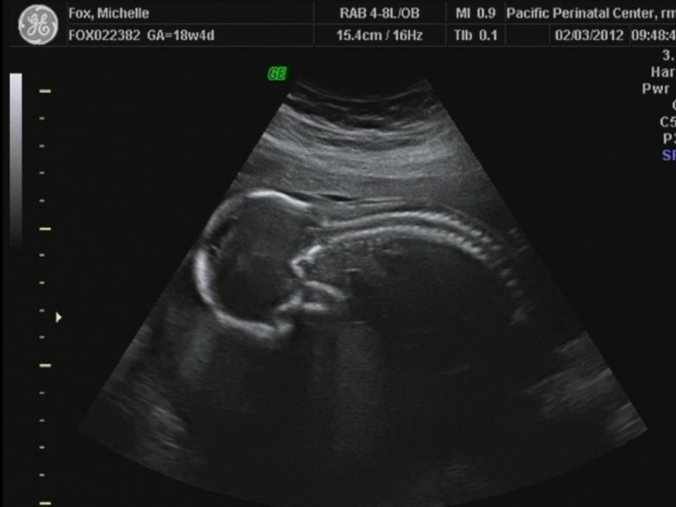
Phasic Fetal Curl/Fear Paralysis
Developmental Course
  9-12 weeks fetal development
  Fetus phasic fetal curl in response to loud sounds
Postural Features
  Phasic activation of flexor muscle group
Autonomic Features
  Metabolic reserve (freeze response)

Slide 19
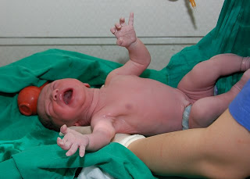
The Moro Response
The first breath
Early postural foundations
Connections to fright, flight, freeze
springcitydiary.blogspot.com
Notes:
19
19

Slide 20
Moro, Startle
Developmental Course
  Fully developed at birth (foreground)
  Loud sound, sudden change in position elicits
  Develops into mature startle by 6 months (background)
Postural Features
  First Phase, phasic postural extension
  Second phase postural extension is modulated by return to body midline and or tonic holding with balance between the front and back side of the body
Autonomic Features
  First phase sympathetic activation
  Second phase modulation of heart with exhale

Slide 21
Moro Development in Relationship to Active Listening Posture
The breath in relationship to sudden change in the environment (movement, sound, peripheral field activation)
Sensory processing challenges, Defensiveness, anxiety
  Lack of response- breath not activated to regulate response to the environment
  First phase- sharp inhale without return to center and exhale- fight flight
  Freeze
Notes:
21
21

Slide 22
Keys to Developing An Active Listening Posture
Inherent patterns for regulation
Inherent patterns to adapt to gravity
Fear Paralysis
Moro
Orienting Response
Primary Movement Patterns (Tonic Labyrinthine)
Righting and Equilibrium Responses (Landau)
Mature postural control
Notes:
22
22
Patterns to adapt to gravity and orient outward

Slide 23
The Tonic Labyrinthine
Emerges at birth
Backward movement of head increases extensor tone
Forward movement of head causes increase in flexor tone
Forward integrated by 4 months of age
Backward integrated by 3 years
Notes:
23
23

Slide 24
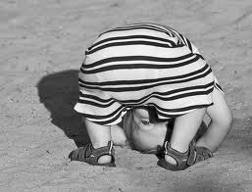
The Tonic Labyrinthine
Tonic Labyrinthine Reflex
Change in tone relative to change in head position
Facilitates a sense of weighted-ness
Pro-gravity tone sets the base for anti-gravity muscle tone
www.breathingtimeyoga.com
Notes:
24
24

Slide 25
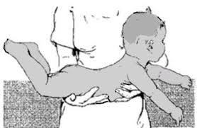

Landau
Full body extension that counterbalances newborn’s total body flexion (phasic)
Fully developed by 6 months (foreground), airplane position, at the time that infant starts to rotate on belly in full extension in circle
Integrated in the third year of life once a secure and mobile walker (background)
Notes:
aThe Landau reaction is elicited by supporting the infant horizontally in the air in the prone position. The reaction is present if the infant raises his head and arches his back with the concavity upwards. A subsidiary part of the response is partial extension of the lower limbs at the hip-joints.
The reaction may be elicited in normal infants from the age of about 3 months onwards, is present in most infants in the second six months of life, and becomes increasingly difficult to evoke after the age of one year.
Absence of the response in infants over the age of 3 months is seen in association with motor weakness, as in cerebral palsy, motor neurone disease and mental retardation.
The Landau reaction represents the combined effects of labyrinthine, neck and visual reactions.
About the balance in the patterns, see athletes who are very stiff and present with difficulty breathing with a bias towards extension

Slide 26
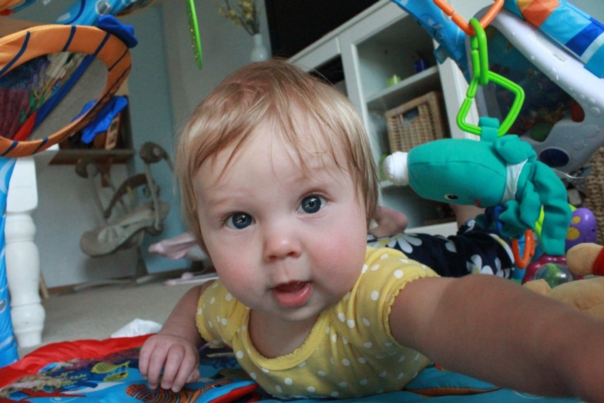


Orienting
www.dailymail.co.uk
Notes:
Independent sitting, standing, interaction between two people

Slide 27
Active Voice Work
Sensory input to activate the sensorimotor patterns that support posture and breath
  Activate the fullest expression of the primary movement patterns
  Work with pro-gravity and anti gravity patterns (play in developmental positions play on the ground)
Activate the breath though positioning, breath and sound play
Combine with Forbrain®

Slide 28
Thank You!
Sheila Frick, OTR/L sheila@vitallinks.net

