Slide 1


Sensorimotor Programs that Support Voice Work
Sheila M. Frick, MS, OTR/L

Slide 2
Sensory Motor Aspects of Voice
How one responds to gravity and sudden changes within the environment predict how well you are able to activate posture and breath
Active voice work is dependent upon activation of the inner core
Integration of hardwired primary movement patterns provide necessary ingredients for development of postural alignment and breath necessary for activation of inner core
Notes:
Posture and movement: how one responds to gravity and sudden changes within the environment predict how well you are able to activate posture and breath
Early patterns are the scaffolding/support for posture and movement
Early movement patterns plus sensory input (change)/adapt comes back to sensory input; how patterns are used and adapted become the first thing you use to respond to the environment as you respond thes patterns change; triggered by sensation and poor sensory motor processing can lead to incomplete or inefficieint sensory motor expression
Typical part of development, can influence emotional state and postural development as well as the use of the visual and auditory attention if they are present beyond their developmental dates they will disrupt development of posture, balance, and regulation of affect (always present in the wiring of the brain, but only expressed beyond an age if there is damage to the brain or stress in the system or asked to accomplish a task beyond your skill level at that moment)

Slide 3
Sensory Motor Aspects of Voice
From assessment to treatment
  Uncover participation limitations rooted in sensorimotor dysfunction
  Identify “un-integrated” primary movement patterns
  Facilitate activation & movement through pattern in games and activities
  Ignite deep postural muscles and animate breath
  Sound it/embodied voice!

Slide 4
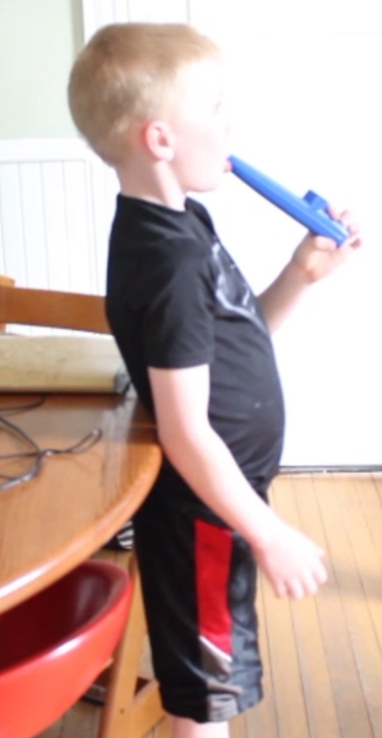
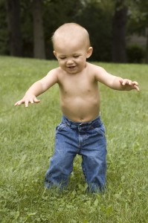
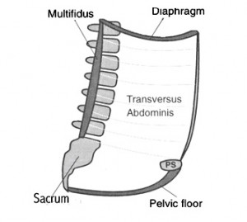
Developing the Core
enabledkids.ca
bretcontreras.com
Notes:
Shelly Mannell and Julie Wiebee references for the inner core—articles from the adult PT literature (NDT framework). We have translated their work into SI treatment. The Hodges respiratory diaphragm. Need to indicate the verticality of the spine
In a number of studies, these muscles have been shown to activate prior to movement, providing an anchor for outer core muscles
Science, inner, outer core and posture
What we know from physical sciences- Hodges

Slide 5
Keys to Developing An Active Listening Posture
Sensorimotor patterns of survival
Sensorimotor patterns to adapt to gravity
Defensive-Orientation Continuum
Primary Movement Patterns
Righting and Equilibrium Responses
Mature postural control
Notes:
5
5
Patterns of protection v. patterns of engagement – rework slide

Slide 6
Review of Primary Movement Patterns
Foundation for postural alignment and breath necessary for activation of inner core:
  Primary protective patterns (Fear paralysis & Moro)
  Primary patterns for orienting in space (Tonic Labyrinthine & Landau)

Slide 7
Unfolding of Primary Movement Patterns
Foreground Windows:
Moro: Inutero to 6 months of age
Tonic Labyrinthine: Birth to 3 years of age
Landau First year of life
Tonic Labyrinthine
Moro
Landau

Slide 8
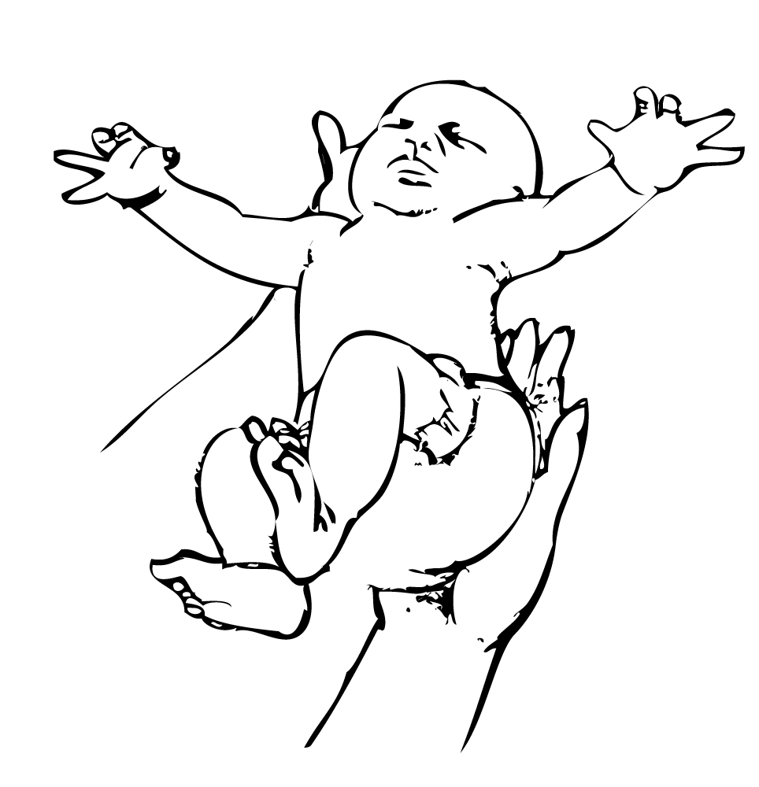
Moro Response
First to emerge 9-12 weeks after conception, continues to fully developed at birth
In fetus, stimulated by loud sound, responds with extension followed by flexion
At birth, elicited by sudden movement of head in relation to torso or sudden movement of the support surface

Slide 9
Tonic Labyrinthine
Allows us to establish a deep bond with the earth before we move into space
  Unfolds as infant learns to manage gravity
Balance tone in the front and back of body
Provides the support tone for all movement against gravity

Slide 10
Landau
Innate drive to master the upright posture
Emerges to get our eyes and ears right with the world to both better process and produce sound
Key hallmark for vertical alignment in standing

Slide 11
Sensory Motor Treatment

Slide 12
Primary Movement Pattern
Sensory input trigger movement pattern
Primary movement pattern fades to background
Motor/Adaptive Response
Volitional Control
Integration Sequence:
Typical integration sequence, but what happens if sequence is disrupted? Or not initiated?
Notes:
What happens with the PMP is not triggered by sensation to turn on?

Slide 13
Facilitation and Integration
Consider the sensory input necessary to trigger
Was the pattern completely developed
Precise proprioceptive input
  Release of holding patterns, gentle oscillations and rhythmical movement
  Activation of pattern with strong proprioceptive input (resistance to movement)
Offer multiple opportunities to experience moving through pattern both in isolation and in function
13

Slide 14
Sensory Input
Vestibular
  Movement of head in all planes
  Linear and angular acceleration
Proprioceptive/Tactile
  Joint and muscle input, pressure touch, resistance to movement
Auditory
  Rhythmical, music, vocalizations
Visual
  Targets; animate and inanimate

Slide 15
Sensory Input
Controlled sensory input and what factors:
  Frequency
  Intensity
  Duration
  Rhythm

Slide 16
Precise Proprioception
Proprioception In and Out of Patterns:
  Moro
    Extension and flexion around core
  Tonic Labyrinthine
    Spinal extension and flexion
  Landau
    Extension against gravity
    Compelled by visually directed goal (targets in space)

Slide 17
Moro Integration
What does integration mean?
  Fullest expression of both the first and second phase and a matched & graded response to stimuli (context dependent) that results in a return to baseline physiology
Moro activities include:
  Strong vestibular input, especially in a backward plane
  Sudden, unpredictable shift in proprioception in response to the support surface
  Element of surprise
Notes:
Video: Jack Moro TX sequence
Activities: Play ball drop, open and close over gym ball, ball boings

Slide 18
Moro Ball Drop Game
Immature:
  Hold breath in response to sudden change
  Lack of activation of extremities or
  Too much tension in extremities
  Short, shallow, irregular breath
Mature/Integrated
  Tone in extremities matches the activity demand
  Breath quickens and returns to resting state/belly

Slide 19
Melting (Tonic Labyrinthine)
Mature
  Balanced postural tone against gravity (not too floppy, not too stiff)
  Background support for postural alignment
Immature
  Poor balance
  Poor stability
  Anxiety around movement
Notes:
Picture of droopy hound dog and doberman pincher

Slide 20
PowerUp Ball Sequence
Finding your center in relationship to others (Moro + Tonic Labyrinthine + Landau)
Belly breath into ball
Roll out into space
Ball balance

Slide 21
Incorporate Sound
Forbrain®
Kazoos
Elongation of the exhale (mmm, ssssss, etc.)
Sound elevators

Slide 22
Thank you!

